Slide 1





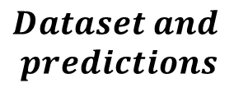

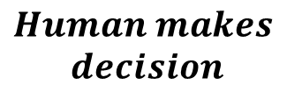


$$Model$$
$$Model$$
$$Dataset and$$
$$predictions$$
$$Pick step$$
$$Explanations$$
$$Human makes$$
$$decision$$

